Slide 1
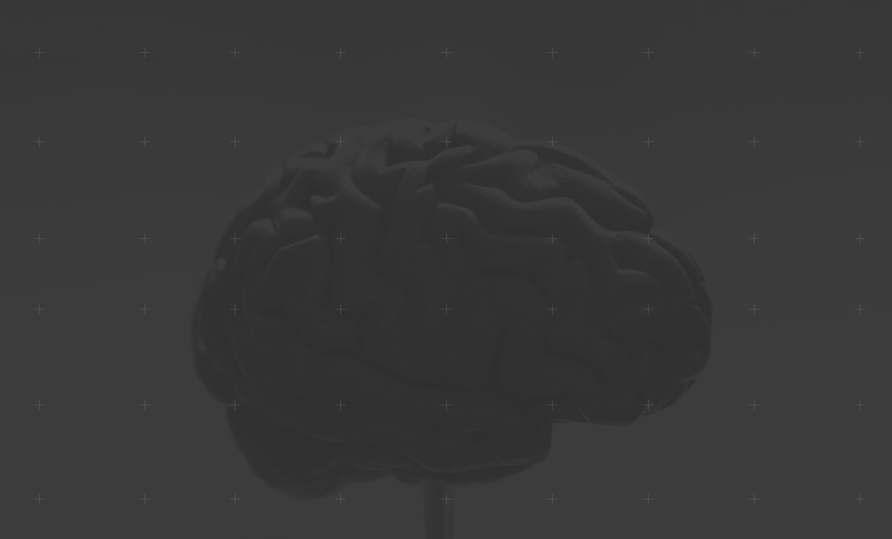
MACHINE LEARNING 101
MACHINE LEARNING FROM
THEORY TO PRACTICE
Notes:
We gonna try to make it as interactive as possible so feel free to ask any questions in the chat bar and we will stop
We gonna send certificate of attendance
This Is being recorded
Pools , background of the audience : Get to know the audience (Computer science, Engineering , Math , Biology,other , .. )
Github repo : https://github.com/farouqBenarous/Machine_Learning_101_Workshop
The main goal is to goal of the workshop is to give you an overview of machine learning , and also we gonna dive into the theory of it and explain different components that it hinges on , and of course we will see some code and how we can put that theory into practice

Slide 2
Machine learning 101
Plan of the workshop :
What is machine learning ?
What types of models are there ?
Models theory and practice ?
Bias vs variance tradeoff
Learning resources

Slide 3


What is machine learning ?
Traditional Computer Science
Data
Output
Program
Computer

Slide 4

What is machine learning ?
Machine learning
Data
Program
Output
Computer

Slide 5
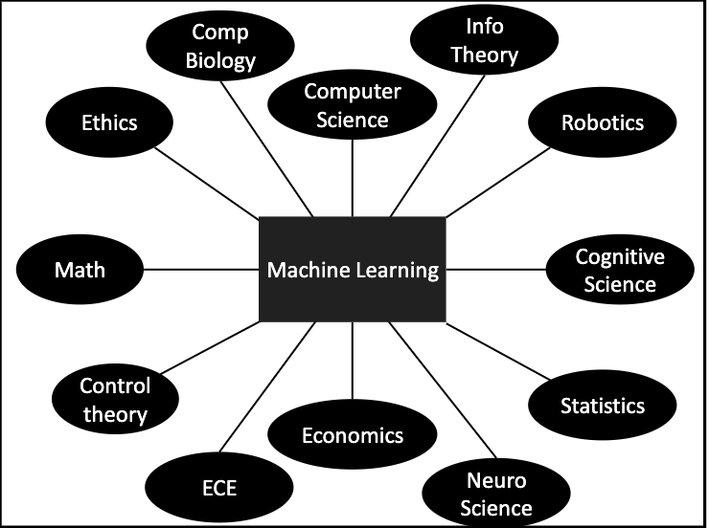
What is machine learning ?
How do they interact
Notes:
One thing we should point out is that all these fields do interact bi with machine learning
They do overlap between each other

Slide 6
What is machine learning ?
Formally : (Mitchell 1997) A computer program A is said to learn from experience E with respect to some class of tasks T and performance measure P, if it’s performance at the tasks T as measured by P improves with E
Informally : Algorithms that improve on some task with experience
Notes:
-talk about history
-improve -> approximations

Slide 7
What is machine learning ?
The task T :
Classification
Regression
Machine translation
Structured input
Anomaly detection
Synthesis and sampling
Imputation of missing value
Denoising
Clustering
The Experience E
Supervised (X,Y)
Unsupervised (X)
Reinforcement learning (Model dynamics , Episodes )
The performance P
Accuracy
Loss
Recall
Notes:
-Anomaly detection : Medical data , intrusion detection
-De-noising : Networking , scientific experiments

Slide 8
What is machine learning ?
The computer program A (the model)
The main component of every model :
Architecture / Baseline
Loss/objective function
Optimizer
Evaluation Metric
Regularizer
Notes:
* Give an example of hard to define loss function self-driving car
* Give a bit of context for optimisation
* regulazer is to prevent over learning

Slide 9
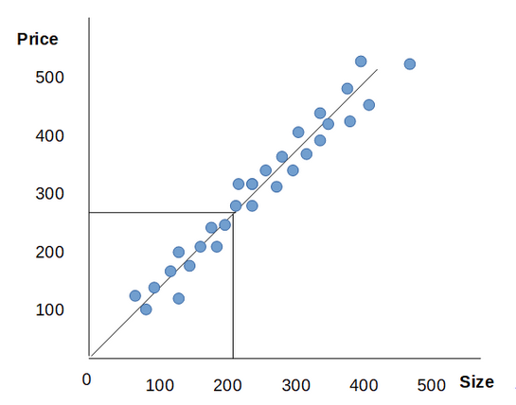
What is machine learning ?
The computer program A (the model)
Housing price prediction Using univariate linear regression
Size | Bedroom | Price *100$
120 | 4 | 400
150 | 3 | 300
200 | 4 | 400
...
300 | 5 | 600
Notes:
* Structured data example

Slide 10
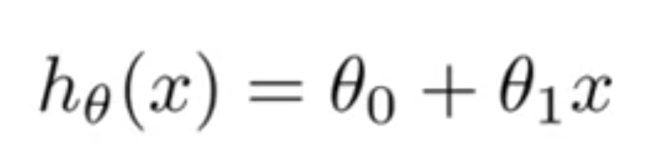
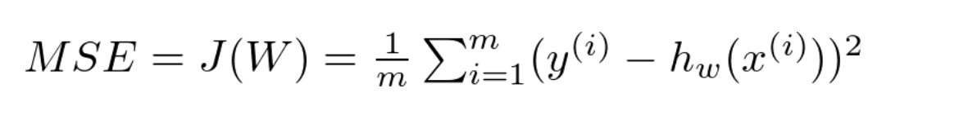
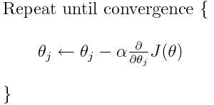
What is machine learning ?
The computer program A (the model)
Housing price prediction Using univariate linear regression
The main component of every model :
Architecture / Baseline :
Loss/objective function : Mean square errors
Optimizer: Gradient Descent
Evaluation Metric: Accuracy
Regulazer: L2 Norm
Notes:
* Give an example of hard to define loss function self-driving car
* Give a bit of context for optimisation

Slide 11
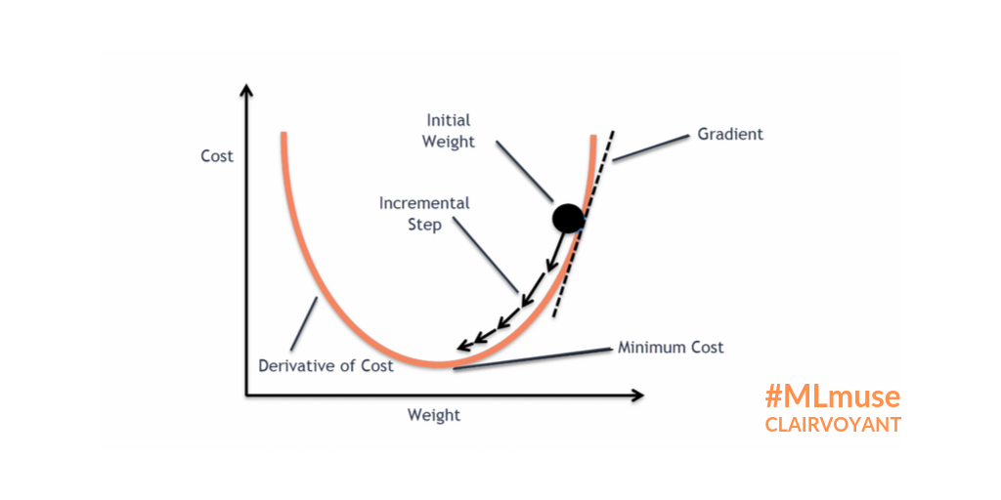
What is machine learning ?
Basic intuition of gradient descent
Notes:
This is the cost function

Slide 12
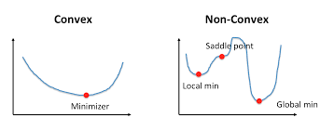
What is machine learning ?
Non-convex optimisation
Notes:
Most of the problems in ML are non-convex
It is valid critics to say that you are solving just locally
In practice local optimization is enough for most of the problems

Slide 13
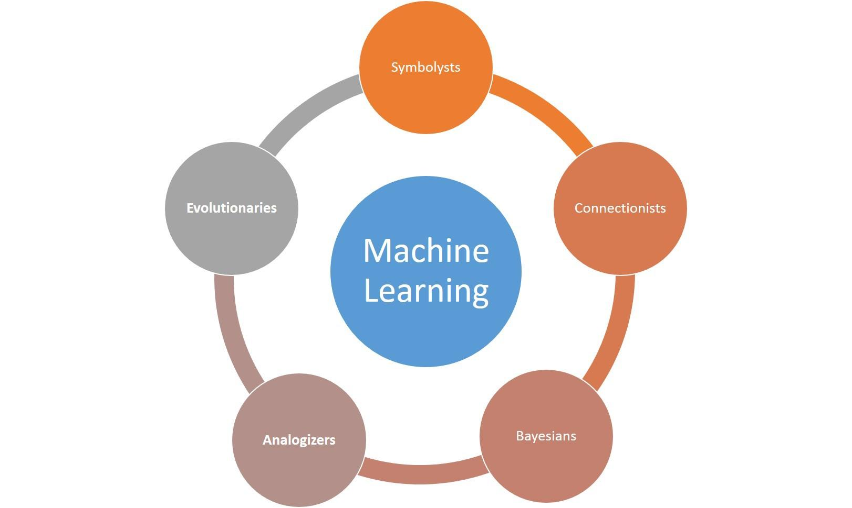
What types of models are there ?
The computer program A (the model)
Notes:
Symbolists:
The intelligence can be reduced to manipulating symbols the way mathematicians do, they do solve equations they way.
They believe that you can’t learn from scratch so we need these symbols and rules encoded before you start making deductions about your data
One of their very popular models were expert systems which is a network of rules
Was rejected in around the 70’s for being unscalable , it started the AI winter
Connectionists:
Learning is all about the brain
The brain learns by connections between neurons
This gave the rise to Artificial neural networks
Evolutionaries:
Hinges on the theory of evolution, the brain didn't just happen to exist it evolved during the course of history
Evolving structures of the brain
They created Genetic algorithms,programming
Basesians:
Basians are concerned with all the other issues we mentioned with uncertainty
Learning itself is a type of uncertain inference
The world is full of uncertainties that comes from different sources: incomplete observations , poor modeling , transition of dynamics
So the problem becomes how we can deal quantify with these uncertainties without falling apart
The naming is from bayes theorem , the theorem tells us how we can incorporate /embed new evidence in our beliefs
Analogierzersz:
Comes from analogy which is making abstractions
The key of learning is recognizing similarities
As example if two patients have same symptoms they might have the same disease, the key is to decide how similar the situations are
The main take away from this slide is that, All of these different categories of model all of them do hinge on very solid scientific intuition, so we should not qualify or disqualify models because of its engineering success
And also when it comes to practice they are not disentangled they do overlap and co-evolve, for example take a neural network and evolve it using a genetic algorithm

Slide 14
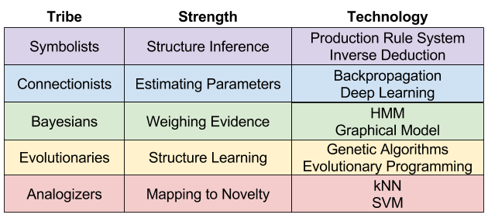
What types of models are there ?
Notes:
* Give example of weather to explain structure vs probabilistic inference
* evolve the structure

Slide 15
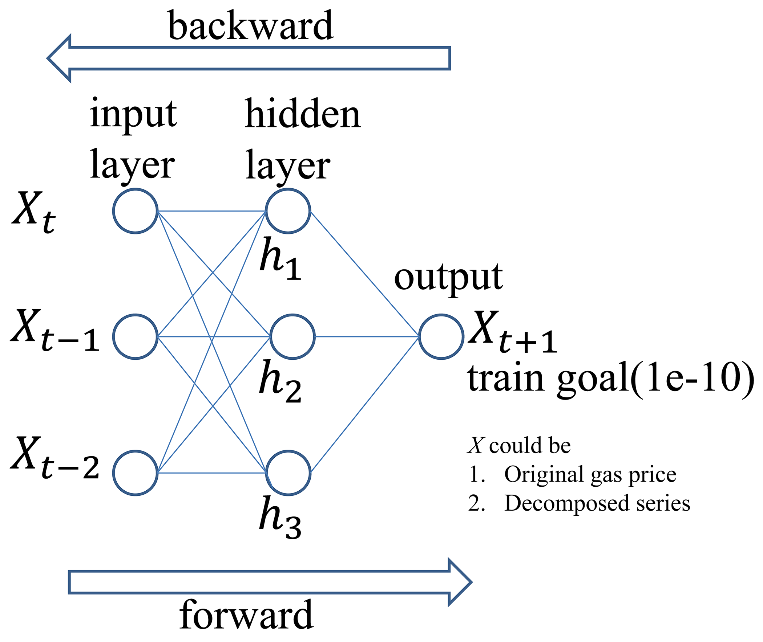
Models Theory and practice ?
Connectionist Master Algorithm : Neural Network
Key observation about ANN :
Layer based model
Composite function
Weighted neurons
Two pathways

Slide 16
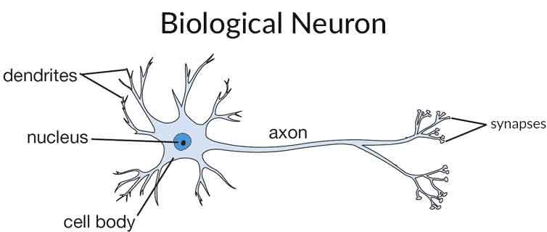
Models Theory and practice ?
Connectionist Master Algorithm : Neural Network
Similarities with artificial neurons :
They have two pathways (neural plasticity)
Composite functions
They are both oriented by data not architecture
They both have hierarchy of representation
(layer structure)
Differences with artificial neurons:
Signals
frequency of firing
Topology
Power consumption (20W vs 250W)
Learning (Optimization) !
Notes:
* Elon.m the brain being as factory
* Quantum effects in the brain
*The main takeaway is that Artificial neural network are a mathematical representation of what we have understood from the brain, however there's still so much we don't now that need to be discovered

Slide 17
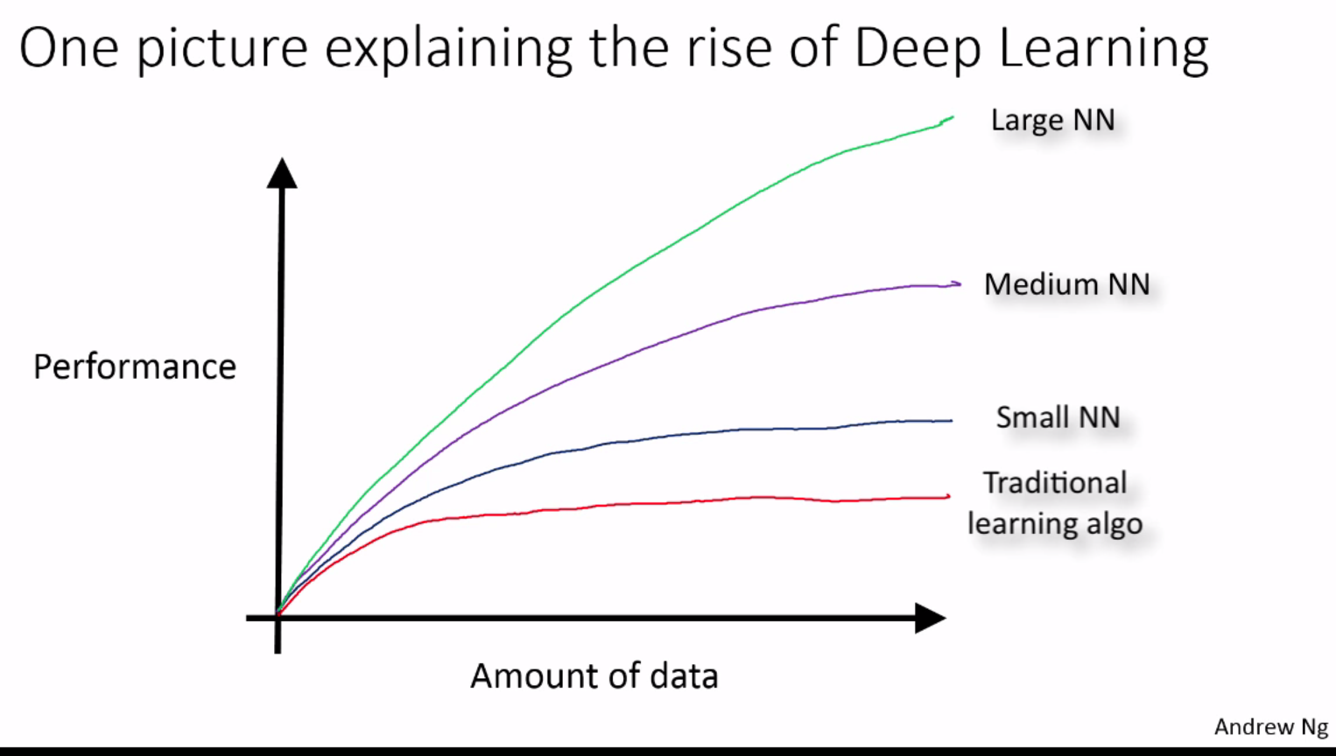
Models Theory and practice ?
Connectionist Master Algorithm : Neural Network
Why do we need them ?

Slide 18
Models Theory and practice ?
Connectionist Master Algorithm : Neural Network
The main component of every model :
Architecture / Baseline : No.Neurons , No.layers , Activation function
Loss/objective function : Cross entropy
Optimizer: Gradient Descent, Backpropagation
Evaluation Metric: Accuracy
Regulazer: L2 Norm , Dropout(Yan la cun 1998)
Notes:
* The NN is gonna produce a probability in the end
* Cross entropy: cross entropy refers to the difference between two probability distributions
* Back propagation : Is one of the novelties in NN discovred by Hinton and William in 1986, it is the use of chain rule and back propagate the gradient

Slide 19
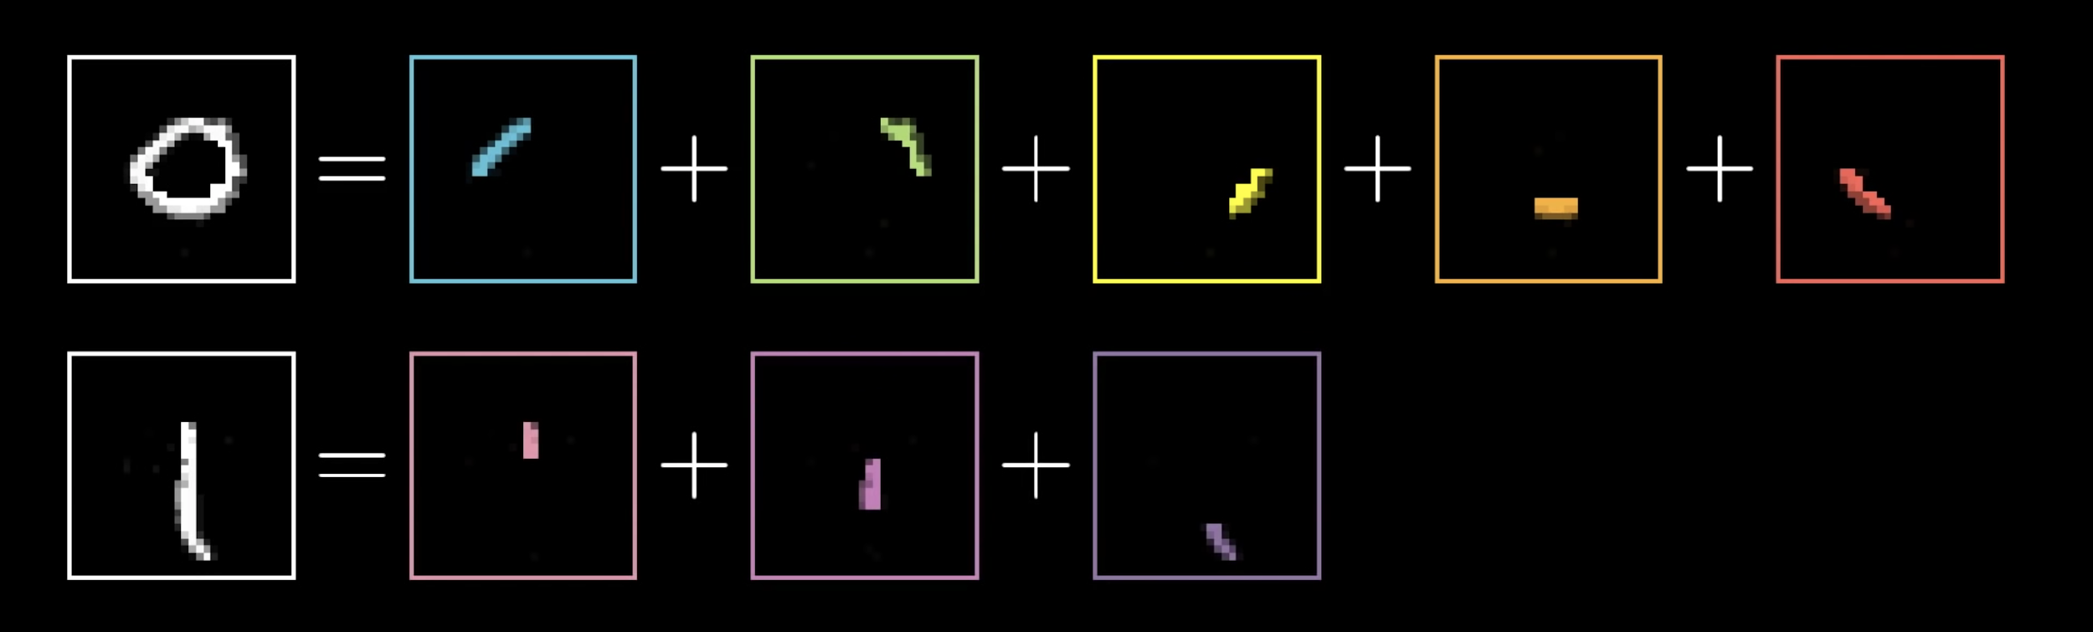
Models Theory and practice ?
Connectionist Master Algorithm : Neural Network
Features captured by the network
Notes:
From stanford , explain the features semantically
Ansdewr the cristics for deep learning about explainibilty

Slide 20
Models Theory and practice ?
Analogizers Master Algorithm : Support Vector machine
What is a Support vector machine ?
Developed by Rosenblatt at AT&T in 1958
It uses a support vectors to calibrate the dividing hyperplane
Intuition that it hinges on ? and how it differs from other models ?
Non-probabilistic Geometric loss function
Maximizing margins(support vectors) between the classes
What’s the use cases of it ?
Regression and classification and even unsupervised learning
It’s simpler and works better with less data, compared to the amount of data needed for NN
It does not work well on data sets with a lot of noise
Is not affected by the curse of dimionalitty
Notes:
* probabilistic ones ,can be used as interval of confidence to classify
* We gonna see the linear version of it , give a hint about kernel methods

Slide 21
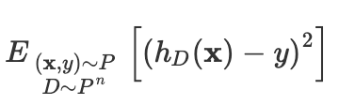
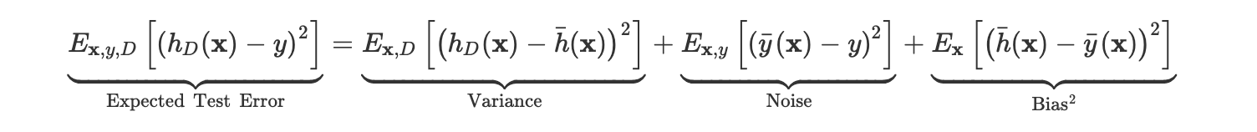
Machine learning 101
Bias vs variance tradeoff
What we have done so far is to reduce the training error/loss
How does that relate to the test error ?
What is the test error/loss decomposition ?
Notes:
Variance:
This is not about the data it's just the model
How different is the our classifier that we drew from our dataset different from the mean classifier (for example we take two classifier and train them how much do they very
This is not about getting it right or wrong
Bias of the model:
We take the Expected classifier subtract it from the label,
Train with the best strategy, your classifier will always make a mistake, fitting a linear model to non linear data,
How biased my model is toward a certain solution
Noise of the data: it represents the fluctuation in the dataset ,the same features the same house the same image can lead to different Y
When you have an algorithm that is not working , It is really important to understand this decomposition
This values can not be inferred directly from the equation, what we can do is obsere some symptoms that we see

Slide 22
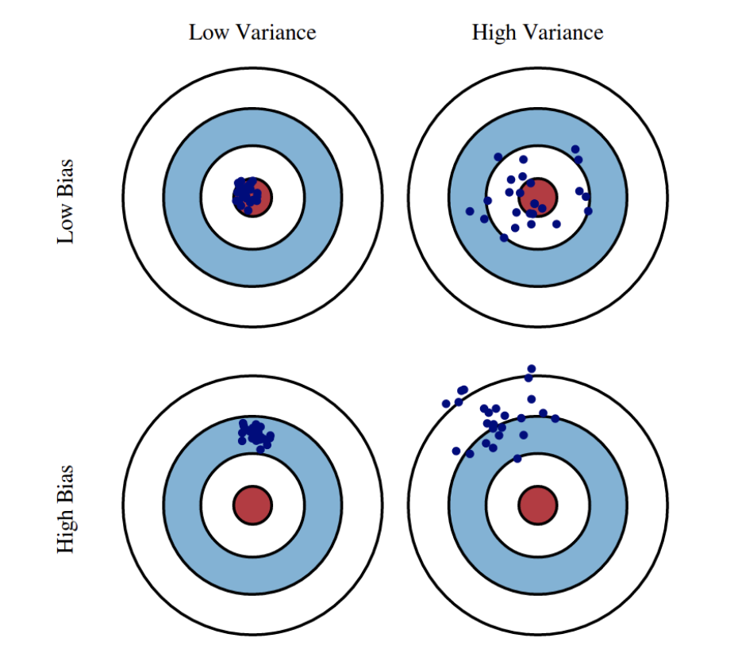
Machine learning 101
Bias vs variance tradeoff
Notes:
Variance: how different is the our classifier that we drew from our dataset different from the mean classifier (for example we take two classifier and train them how much do they very , this is not about getting it right or wrong)
Bias of the model: we take the Expected classifier subtract it from the label, You have infinite dataset, you classifier will always make a mistake, example fitting a linear model to non linear data, How biased my model is toward a some feature,model is focusing of features that is shouldn’t ve
Noise of the data: it represents the fluctuation in the dataset ,the same features the same house the same image can lead to different Y

Slide 23
Machine learning 101
Bias vs variance tradeoff
High Variance (overfitting)
In the first regime, the cause of the poor performance is high variance.
Symptoms:
Training error is much lower than test error
Training error is lower than desired error threshold
Remedies:
Add more training data
Reduce model complexity, complex models are prone to high variance
Add regularizer
Bagging : averaging models
High Bias (underfitting)
Unlike the first regime, the second regime indicates high bias: the model being used is not robust enough to produce an accurate prediction.
Symptoms:
Training error is higher than desired error threshold
Remedies:
Use more complex model (e.g. kernelize, use non-linear models , add more neurons ...)
Add features

Slide 24
Machine learning 101
Learning resources
Loss functions: https://machinelearningmastery.com/loss-and-loss-functions-for-training-deep-learning-neural-networks/
Optimisation: Chapter 8 of deep learning textbook https://www.deeplearningbook.org/contents/optimization.html
Evaluation metrics: https://machinelearningmastery.com/tour-of-evaluation-metrics-for-imbalanced-classification/
Regularization: Chapter 7 of the deep learning textbook https://www.deeplearningbook.org/contents/regularization.html
Building Models:
Coursera Machine learning course by andrew-ng https://www.coursera.org/learn/machine-learning
Coursera Deep learning specialisation https://www.coursera.org/specializations/deep-learning
If You want more detaild /long course that tackels all the nerdy dirty details here it is by Kilian Weinberger from cornell university https://www.youtube.com/watch?v=xpHQ6UhMlx4&list=PLl8OlHZGYOQ7bkVbuRthEsaLr7bONzbXS
Bias vs variance tradeoff: https://www.cs.cornell.edu/courses/cs4780/2018fa/lectures/lecturenote12.html
Math recap for machine learning: https://www.deeplearningbook.org/contents/part_basics.html
Reinforcement learning textbook: https://web.stanford.edu/class/psych209/Readings/SuttonBartoIPRLBook2ndEd.pdf

Slide 25
Machine learning 101
Recap
What is machine learning.
What types of models are there.
Model examples (theory and code).
Bias vs variance tradeoff
Learning resources

Slide 26
MACHINE LEARNING 101
MACHINE LEARNING FROM
THEORY TO PRACTICE
Thank you very much for your attention
Farouq benarous
Emmanuel fonseca
Pedro evangelista
Notes:
We gonna try to make it as interactive as possible so feel free to ask any questions in the chat bar and we will stop
We gonna send certificate of attendance
This Is being recorded
Pools , background of the audience : Get to know the audience (Computer science, Engineering , Math , Biology,other , .. )
Github repo : https://github.com/farouqBenarous/Machine_Learning_101_Workshop
The main goal is to goal of the workshop is to give you an overview of machine learning , and also we gonna dive into the theory of it and explain different components that it hinges on , and of course we will see some code and how we can put that theory into practice

